Slide 1

Jaipur Engineering College & Research Centre
Department of Computer Science and Engineering
A
Seminar
on
Cloud Computing
Submitted to:
Mr. Hemant Mittal(Guide)
Assistant Professor
Computer Science & Engineering
Session: 2025-26
Presented By
Student Name:Yash Joshi
Roll. No.: 22EJCCS851
Semester and Year: 7th Sem 4th Year

Slide 2
Contents
Objective
Introduction to Cloud Computing
Characteristics of Cloud Computing
Cloud Service Models (IaaS, PaaS, SaaS)
Deployment Models (Public, Private, Hybrid, Community)
Cloud Architecture
Major Cloud Providers (AWS, Azure, GCP)
Cloud Storage & Data Management
Security in Cloud Computing
Cloud Applications & Use Cases
Advantages of Cloud Computing
Challenges in Cloud Computing
Methodology
Material Required
References

Slide 3
Objective
On-demand resource access
Reduced infrastructure cost
High scalability & flexibility
Reliable and available services
Global remote access
Better data management
Enhanced collaboration
Faster innovation

Slide 4
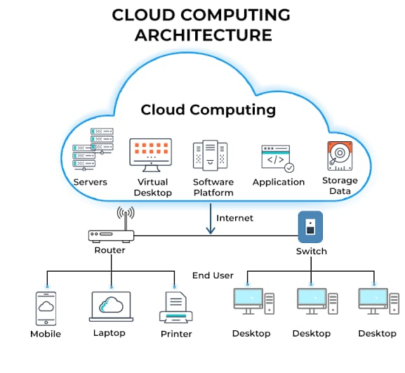
Introduction To Cloud Computing
Cloud computing is a modern computing technology that delivers computing services such as servers, storage, databases, software, and networking over the internet on a pay-as-you-use basis. Instead of relying on a personal computer or physical infrastructure, users can access resources remotely from anywhere, anytime.
Cloud computing helps organizations reduce hardware cost, increase scalability, and ensure high performance and reliability. Popular cloud platforms like AWS, Azure, and Google Cloud power many everyday applications such as Gmail, Netflix, and Google Drive, making data storage and access faster, secure, and more efficient.
.

Slide 5
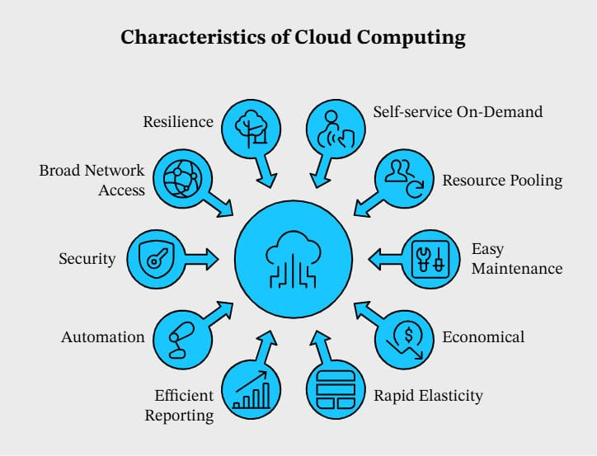
Characteristics Of Cloud Computing
Cloud computing offers flexible and scalable access to computing resources over the internet. It allows users to use IT services on demand without needing physical infrastructure. These characteristics make cloud computing efficient, cost-effective, and widely adopted by modern organizations.
On-Demand Self-Service
Broad Network Access
Resource Pooling
Rapid Elasticity & Scalability
Pay-As-You-Go Pricing
Measured Service & Monitoring

Slide 6
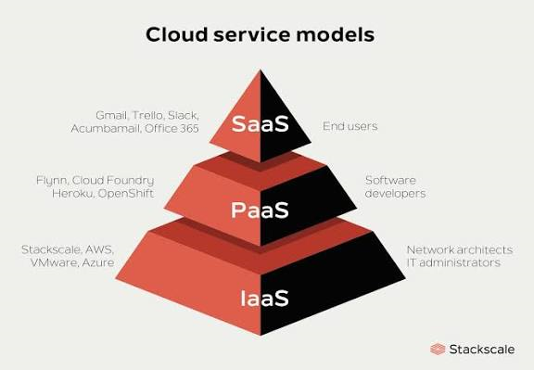
Cloud Service Models
Cloud computing delivers services through three main models. Each model provides different levels of control, flexibility, and management for users. These service models help organizations choose the right level of service according to their needs.
Service Models
IaaS (Infrastructure as a Service)
Provides virtual servers, storage, networking, and other infrastructure on rent.
Example: AWS EC2, Google Compute Engine
PaaS (Platform as a Service)
Offers a platform for developers to build, deploy, and manage applications without managing infrastructure.
Example: Google App Engine, Microsoft Azure App Services
SaaS (Software as a Service)
Delivers fully managed software applications accessible via internet.
Example: Gmail, Google Drive, Salesforce

Slide 7
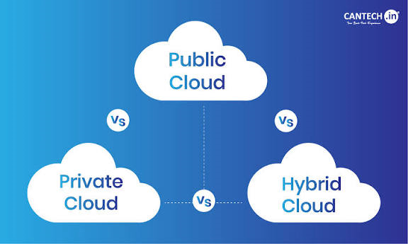
Deployment Models
Public Cloud
Services offered over the internet and shared among multiple users.
Example: AWS, Azure, Google Cloud
Private Cloud
Cloud infrastructure dedicated to a single organization for enhanced security and control.
Example: On-premise VMware Cloud
Hybrid Cloud
Combination of public and private clouds, allowing data and applications to move between them.
Example: Azure Hybrid Cloud
Community Cloud
Shared infrastructure used by a specific group or community with common concerns (e.g., banks, universities, governments).

Slide 8
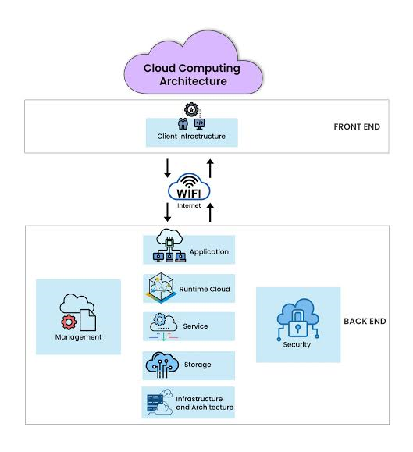
Cloud Architecture
Cloud architecture refers to the structure and design of the systems and technologies that enable cloud computing. It includes the front-end interfaces used by users, the back-end infrastructure where processing and storage occur, and the virtualization layer that allows multiple virtual resources to run on shared hardware. A strong cloud architecture ensures scalability, security, high availability, and efficient delivery of cloud services.
Front-end (user interface & client devices)
Back-end (servers, databases, applications)
Virtualization layer
Cloud storage system
Networking system
Cloud management & security tools

Slide 9
Cloud Providers
Cloud computing services are offered by several global technology companies that provide powerful infrastructure, platforms, and software solutions over the internet. These providers offer scalable services, high security, global data centers, and advanced tools for computing, storage, AI, and application deployment.
Amazon Web Services (AWS)
Largest cloud platform offering wide range of services including compute (EC2), storage (S3), and databases (RDS).
Microsoft Azure
Popular for enterprise solutions, hybrid cloud, and integrations with Microsoft products like Windows Server & Office 365.
Google Cloud Platform (GCP)
Known for strong data analytics, machine learning, and scalable Kubernetes-based solutions.
.

Slide 10
Cloud Storage And Data Management
Cloud storage and data management allow users and organizations to store, access, and manage data over the internet instead of local systems. It ensures secure storage, easy access from anywhere, scalability based on demand, and protection against data loss. Cloud data management also includes backup, recovery, and efficient organization of data for smooth business operations.
Key Points:
Remote Data Storage — Access files and databases online anytime
Scalability — Increase or decrease storage as needed
Data Backup & Recovery — Prevent data loss and enable quick restoration
Security & Encryption — Protect stored information from unauthorized access
High Availability — Access data even during system failures
Examples: Google Drive, AWS S3, OneDrive, Dropbox

Slide 11
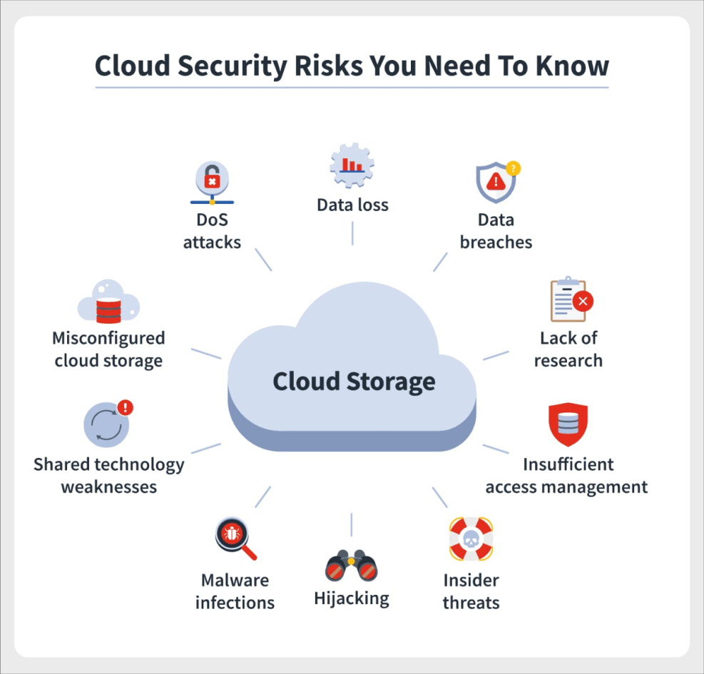
Cloud Security
Security in cloud computing ensures that data, applications, and services stored online are protected from unauthorized access, cyber-attacks, and data breaches. Cloud security uses advanced encryption, access controls, monitoring, and compliance policies to maintain privacy and trust. Strong security measures help organizations safeguard sensitive information while benefiting from cloud technology.
Key Security Features:
Data Encryption
Access Control & Authentication
Firewalls & Intrusion Detection
Regular Security Audits & Monitoring
Backup & Disaster Recovery
Compliance Standards \

Slide 12
Cloud Applications
Cloud computing is used across multiple fields to store data, run applications, analyze information, and deliver digital services efficiently.
Applications & Use Cases
Business & Enterprises — CRM, ERP, data storage, remote teams
Education — Online learning, digital libraries, virtual labs
Healthcare — Patient records, telemedicine, AI diagnostics
Banking & Finance — Online banking, fraud detection, databases
Entertainment & Media — OTT platforms, gaming, streaming (Netflix, YouTube)
E-Commerce — Online stores, inventory systems, personalized recommendations
Software Development — DevOps, CI/CD, testing environments
Government & Smart Cities — Digital services, surveillance, e-governance

Slide 13
Advantages of Cloud Computing
Cloud computing offers several benefits that make it widely used by individuals and organizations. It provides flexibility, cost savings, and efficient access to computing resources, improving productivity and accelerating innovation.
Key Advantages
Cost Efficient — No need for expensive hardware and maintenance
Scalability — Easily increase or decrease resources as needed
Accessibility — Access data and services anytime, anywhere
High Performance — Fast processing, automatic updates, global servers
Reliability — Backup, disaster recovery, and high uptime
Better Collaboration — Real-time sharing and teamwork from any location
Automatic Updates — System and security updates handled by provider
Environment Friendly — Optimized resource usage reduces energy waste

Slide 14
Challenges in Cloud Computing
Cloud computing brings many benefits but also faces several challenges related to security, cost management, and dependency on network and service providers. Organizations must address these issues to fully leverage cloud technology effectively.
Key Challenges
Security & Privacy Concerns
Risk of data breaches and unauthorized access
Downtime & Internet Dependency
Requires stable internet; outages affect access
Data Transfer & Latency Issues
Delay in accessing cloud services for remote users
Vendor Lock-In
Difficulty in switching between cloud providers
Cost Management
Improper resource usage can increase expenses

Slide 15
Methodology
Problem Definition and Requirements Analysis
System Design
Device and Sensor Integration
Data Processing and Analysis
Application Development and User Interface
Deployment and Testing
Maintenance and Monitoring
Security Measures

Slide 16
Material and Facilities Required
Materials Required:
Hardware:.
Software:
Networking Equipment:
Testing and Debugging Tools:
Facilities:
Personnel:

Slide 17
References
Cloud Computing and Its Applications P. Mell and T. Grance, ―The NIST Definition of Cloud Computing,‖ National Institute of Standards and Technology, Special Publication 800-145, 2011. doi:10.6028/NIST.SP.800-145
A Survey on Cloud Computing: Architecture, Services, and Challenges M. Armbrust et al., ―A View of Cloud Computing,‖ Communications of the ACM, vol. 53, no. 4, pp. 50 58, 2010. doi:10.1145/1721654.1721672
Security and Privacy in Cloud Computing S. Subashini and V. Kavitha, ―A Survey on Security Issues in Service Delivery Models of Cloud Computing,‖ Journal of Network and Computer Applications, vol. 34, no. 1, pp. 1–11, 2011. doi:10.1016/j.jnca.2010.07.006

